Slide 1
Classes and objects

Slide 2
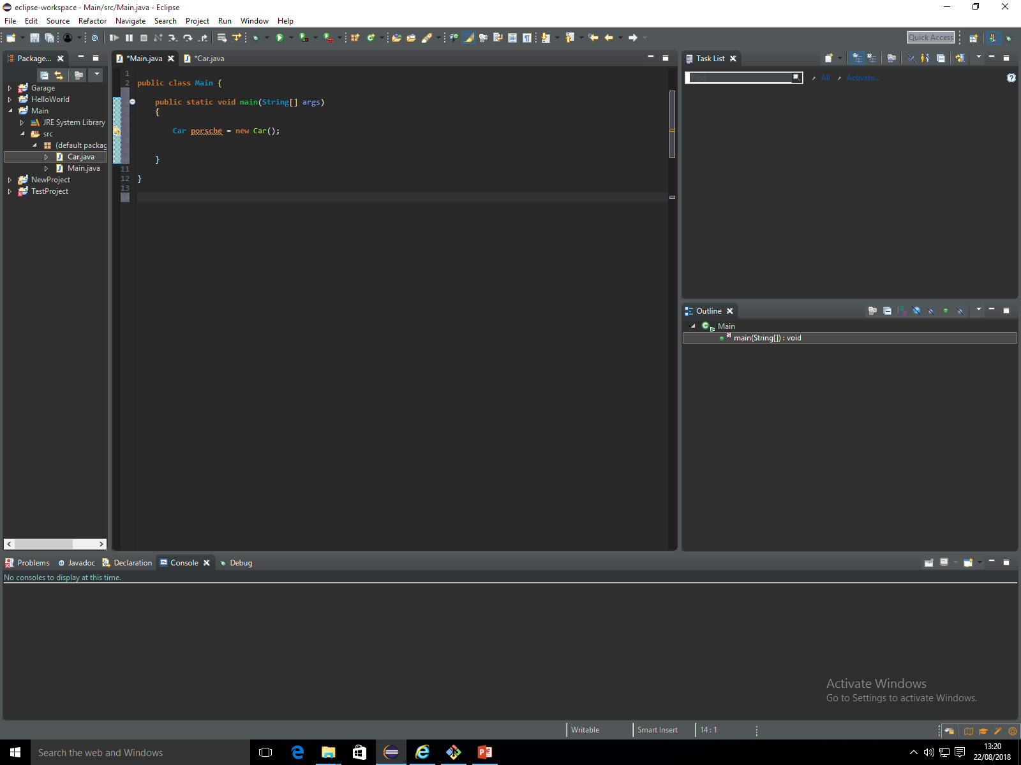
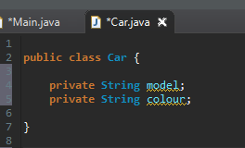
Visualise a table being created from the Car class that should be populated for each object.
Each variable defines a column heading and stores the objects.
Objects
Car reference Model Colour
Because we have created a class called Car we have now treat that as a data type.

Slide 3
We want to create an object, we would create this exactly how we create a normal variable.
To create a variable we need to follow this structure:
DataType VariableName AssignmentOperator Value
DataType VariableName AssignmentOperator Value
We are creating a new object with the variableName(ObjectReference) of “Porsche” that is going to be calling for information from the Car class. Porsche needs to follow the template of the Car class e.g. needs to be passed parameters ( in this case “model” and “colour”. The new keyword is creating a space in the memory for an object of a particular class ( in this case the Car class ) and returning a reference to it.

Slide 4

A constructor can exist without an object reference; however as soon as Java is ran it will be deleted if it does not have a reference. For example, this line of code will not error out however it would be deleted as soon as the program is ran.
The Porsche object will not let this constructor be deleted. This
Is because Porsche is creating a reference to it.
911
Red
Although the constructor is not yet passing any parameters it still exists and is not being deleted unlike the other constructor which holds “911” and “Red”.
Porsche
Object Reference
Parameters from constructor

Slide 5
Passing parameters from the Car class to the “Porsche” object.
We can’t assign a value from Car straight to our Main method because the variables are private.

Slide 6
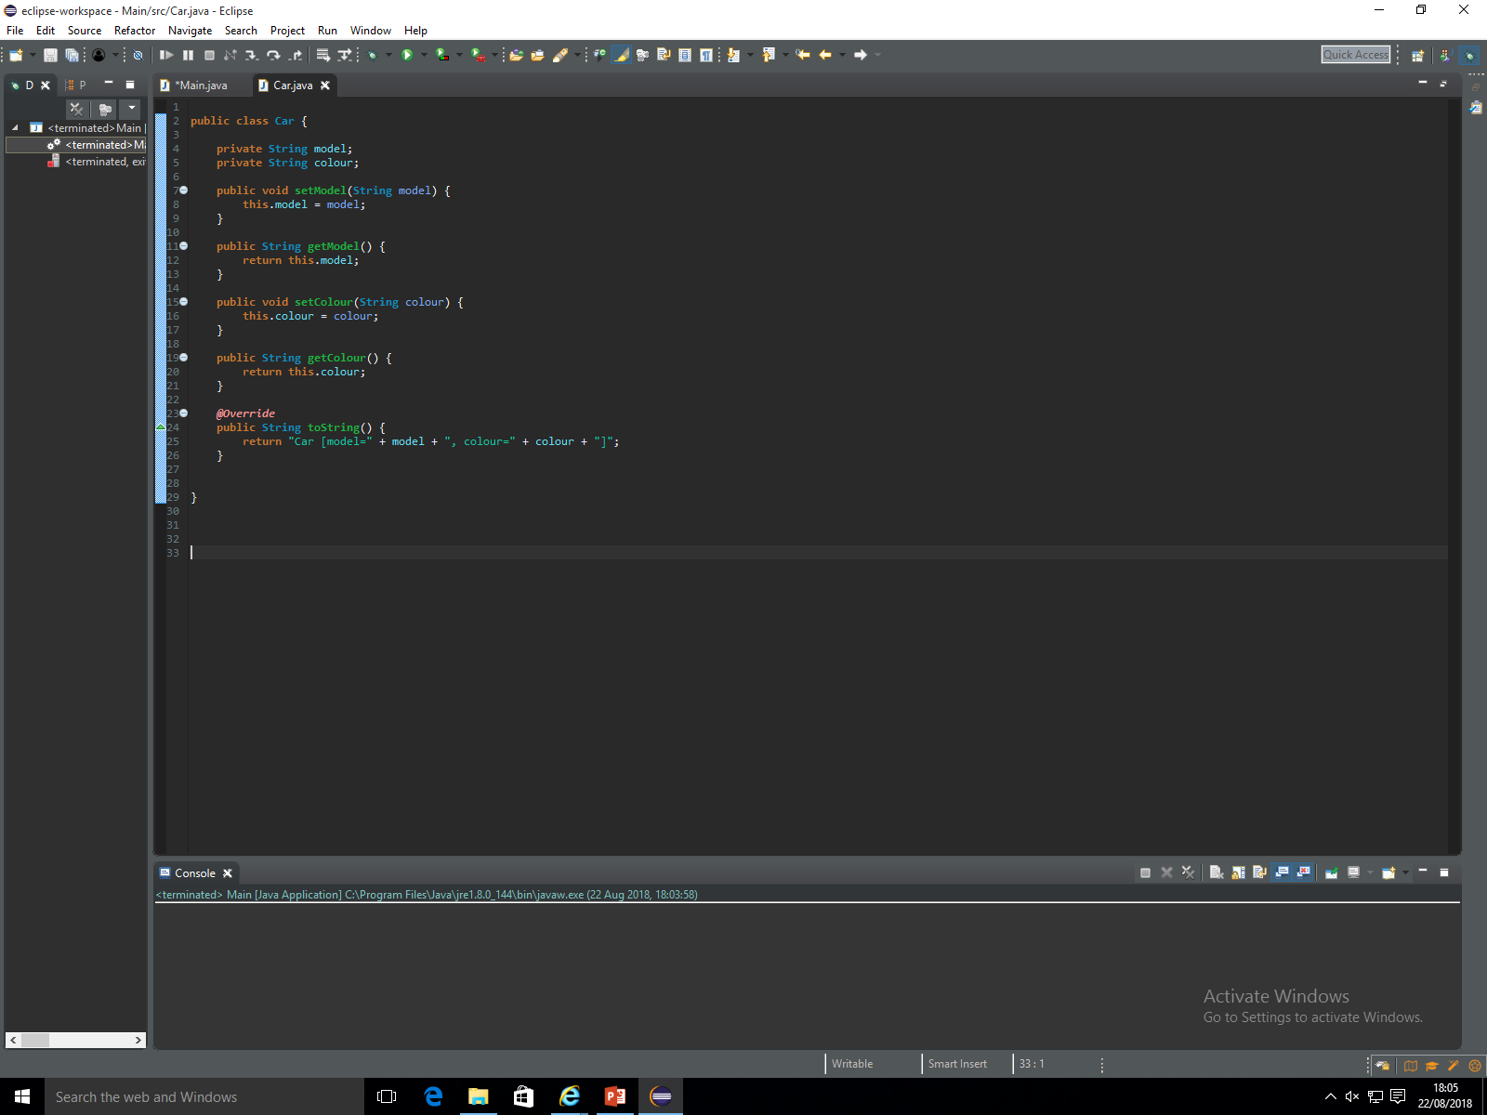
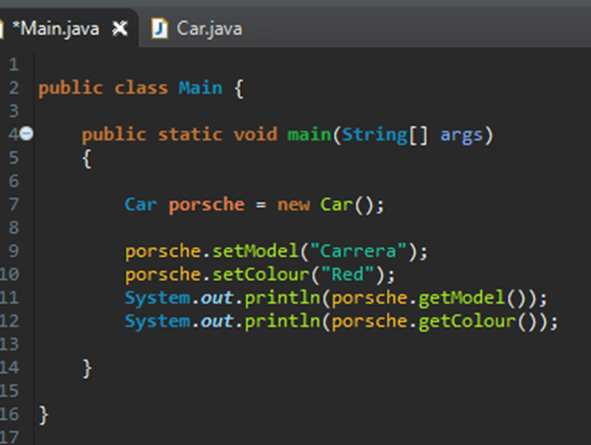
Here we have two different types of variables, field variables and parameter variables.
Field Variables
Parameter Variable
This code is saying set our field variable called model with whatever parameter is passed into the parameter model.
We are passing the parameter into the parameter model variable through the main class by using:
porsche.setModel(“Carrera”);
This is passing the String Carerra into the parameter model which is then subsequently passed into the field model.

Slide 7
Visualisation
This empty object now has the following stored into it
Model:Carrera
We are now going to get that value and display it.
Porsche
Model:Carrera
Parameters from constructor

Slide 8
The first thing we need to do is create a ‘getter’ in our Car class. We used the setters previously to store the String “Carrera” into our field variable model.
We now want to display whatever is stored in the field model.
This line of code is saying when this method is ran, return the value of the field model within this class.
We will now call them from the main class.

Slide 9
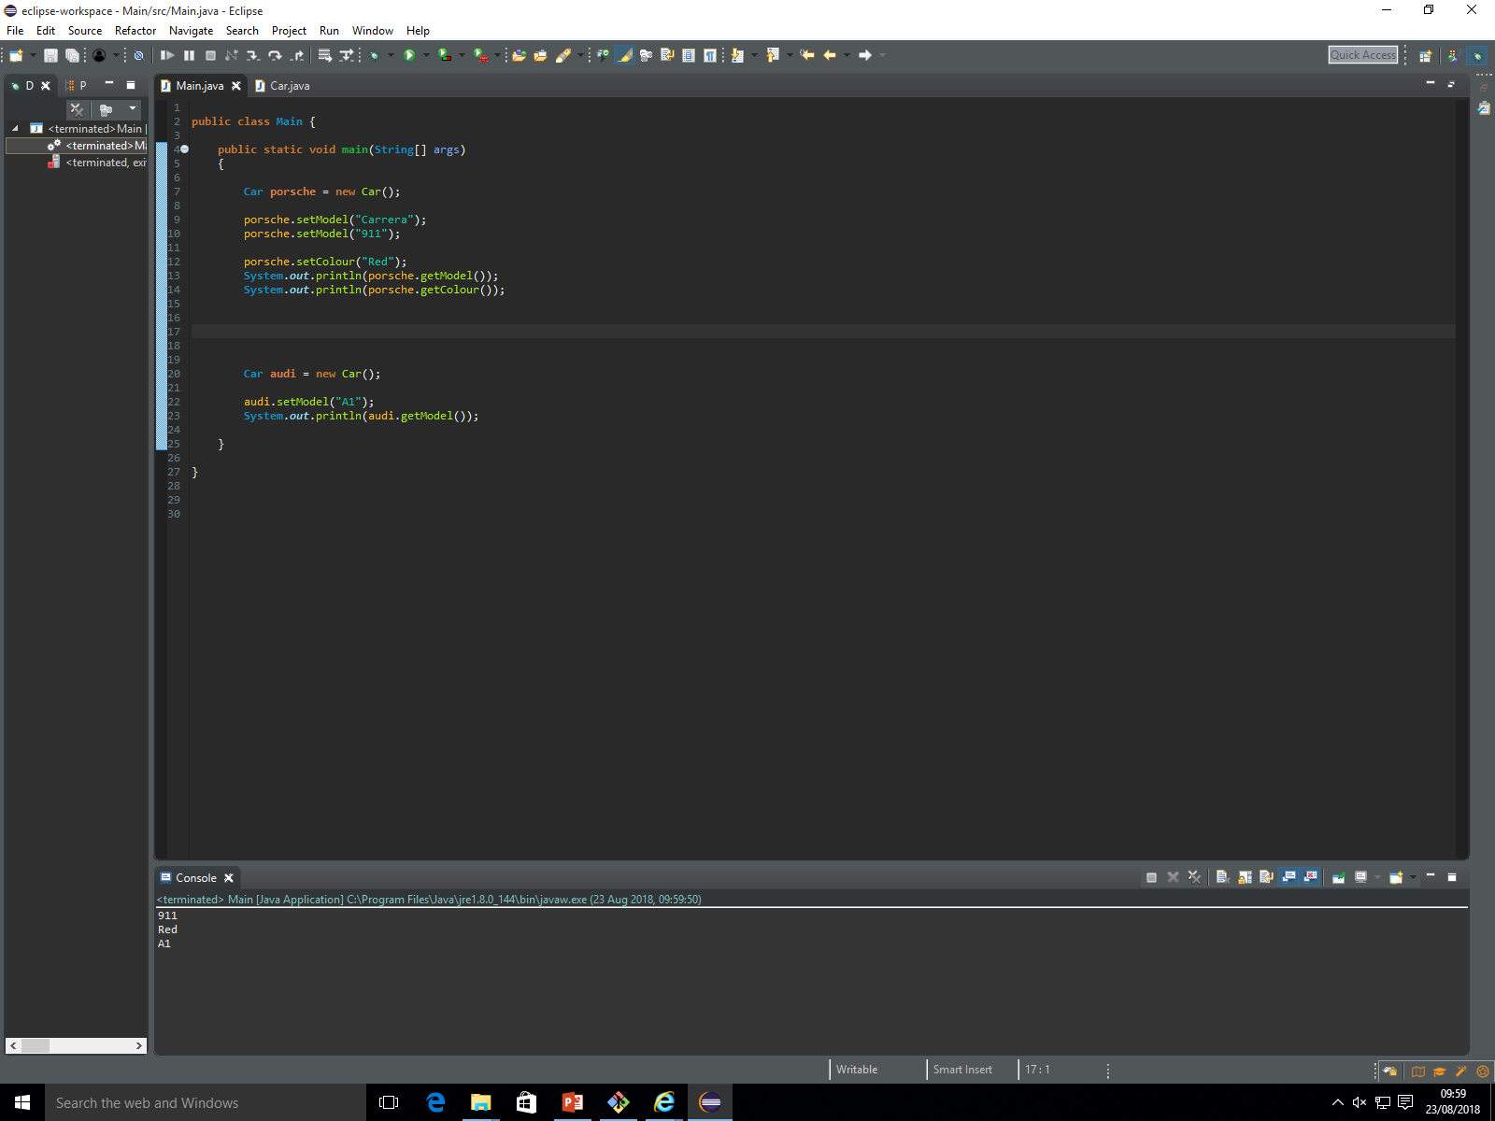
We are now saying, find the value stored in the field model with the object reference of Porsche and print it out.
If we try to store another model it will overwrite whatever we have previously e.g. lets say we want Porsche to now be 911.
This will now print out 911 instead of Carrera as we have overwritten it.
Porsche
Porsche
Model:Carrera
Model:911

Slide 10

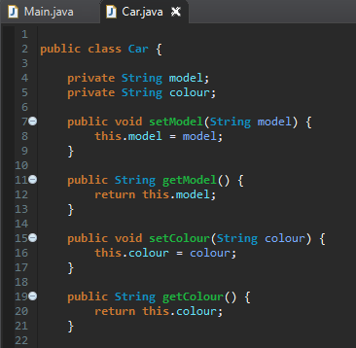
What we can do however is create another car, so lets say we want an Audi A1.
We have created a new object with the object reference of ‘audi’.
We do not have to create new setModel and getModel methods as each parameter is stored with the object reference. For example (look on the next slide).
We have set the model as ‘A1’.
We are then retrieving whatever is in the field model (in this case A1) and printing it out.

Slide 11
Object reference Model Colour
Porsche Carrera Red
Audi A1
We have not stored a colour for the Audi at the moment hence why it is blank.
When we use ‘getModel’ we are getting the model with the same object reference so for example
This is basically saying, find me the Audi object reference, then get whatever value is stored in model.

Slide 12
Both of these objects are referenced in the Car class, a better way to visualise this is below:
Car
Porsche
Audi
Model:Carrera
Model:A1

